Slide 1

Academic Session 2026-27
ODD Semester July-Dec 2026
UNIVERSITY INSTITUTE OF ENGINEERING AND TECHNOLOGY
Department of TT
Bachelor of Engineering (B.E.) – CSE
Advanced Data Structures / Semester 3
(CS221)
Unit No. 1 Chapter No. 1.1 Lecture No. 6
Topic : Searching – Linear Search and Complexity Analysis
Abhishek Thakur (E19789) Technical Trainer
Sourav Jaiswal (E19756)-MSC Technical Trainer

Slide 2
Learning Objectives
Understand the linear search algorithm and its step-by-step working.
Analyse best, average, and worst-case time complexity of linear search.
Implement linear search in pseudocode and trace through an example.
Identify conditions where linear search is the preferred technique.

Slide 3

Linear Search – Algorithm
Definition: Linear search scans each element from left to right until the key is found or the array is exhausted.
Algorithm: LINEAR_SEARCH(A,n,key): k=0; while k<n: if A[k]==key: return k; k++; return -1
No precondition: Works on both sorted and unsorted arrays equally well.
Return value: Returns the index of the first match, or -1 if not found.
Use case: Preferred for small arrays, unsorted data, or one-time searches.

Slide 4
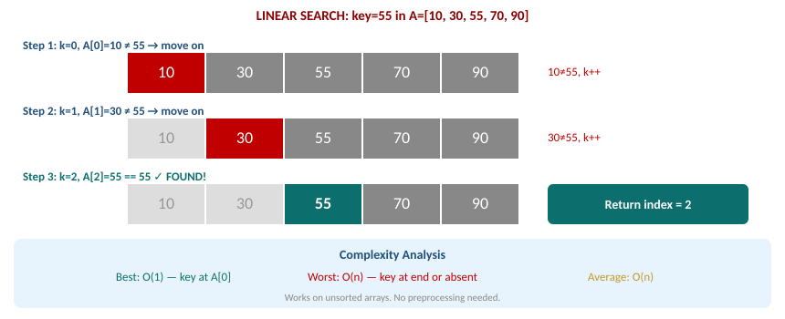
Linear Search – Step-by-Step Trace & Complexity

Slide 5
Summary of the Lecture
Linear search checks each element sequentially without requiring sorted input.
Best case: O(1) — key found at index 0. Worst case: O(n) — at end or absent.
Average case is O(n/2) which simplifies to O(n) in Big-O notation.
Suitable for small datasets or when sorting overhead is not justified.
For large sorted datasets, Binary Search O(log n) is far more efficient.

Slide 6
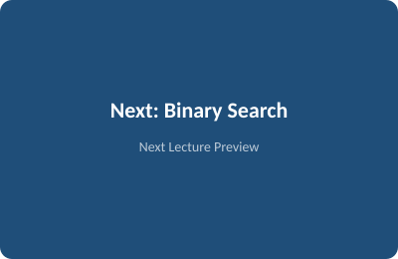
Next Lecture
Binary Search – algorithm, step-by-step trace, and O(log n) complexity derivation.

Slide 7
Quiz/ FAQ's
Q1. Trace linear search on A=[4,8,12,16,20] for key=12. Count comparisons.
Q2. What is the worst-case complexity of linear search? When exactly does it occur?
Q3. In what three situations is linear search preferred over binary search?

Slide 8
References/ Articles
Seymour Lipschutz, Data Structures, Schaum's Outlines, McGraw-Hill.
GeeksforGeeks – Linear Search: https://www.geeksforgeeks.org/linear-search/
Visualgo – Sorting/Searching: https://visualgo.net/en/sorting

Slide 9
Thank You
For queries
Email: abhishek.e19789@cumail.in

